Slide 1
Topological Data Analysis
Jesse Wolfson
University of Chicago
2016 REU

Slide 2
Challenges of Data

Slide 3
Challenges of Data
Size (“Big Data”)

Slide 4
Challenges of Data
Size (“Big Data”)
Complexity

Slide 5
Challenges of Data
Size (“Big Data”)
Complexity
  Format

Slide 6
Challenges of Data
Size (“Big Data”)
Complexity
  Format
  Structure

Slide 7
Challenges of Complexity
Need organizing principles

Slide 8
Data has a shape

Slide 9
Data has a shape

Slide 10
Data has a shape

Slide 11
Data has a shape

Slide 12
Data has shapes

Slide 13
Data has shapes
Linear

Slide 14
Data has shapes
Clusters

Slide 15
Data has shapes
Holes

Slide 16
Data has shapes

Slide 17
How do we measure shape?
Connectivity

Slide 18
How do we measure shape?
Connectivity, i.e.
  # of clusters

Slide 19
How do we measure shape?
Connectivity, i.e.
  # of clusters
  # of holes

Slide 20
How do we measure shape?
Connectivity, i.e.
  # of clusters
  # of holes
  # of higher dimensional analogues

Slide 21
Connectivity - Shortcomings

Slide 22
Connectivity - Shortcomings
May be only one aspect of the relevant shape, e.g.

Slide 23
Connectivity - Shortcomings
Connectivity may only be one aspect of the relevant shape, e.g.
O = P

Slide 24
Connectivity - Shortcomings
Connectivity may only be one aspect of the relevant shape, e.g.
O = P
X = Y

Slide 25
Connectivity – Advantages

Slide 26
Connectivity – Advantages
Coordinate independent

Slide 27
Connectivity – Advantages
Coordinate independent
Stable under small changes in the data

Slide 28
Connectivity – Advantages
Coordinate independent
Stable under small changes in the data
Compressed representation

Slide 29
Persistent homology
Homology

Slide 30
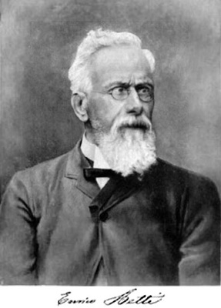
Persistent homology
Homology
Enrico Betti

Slide 31
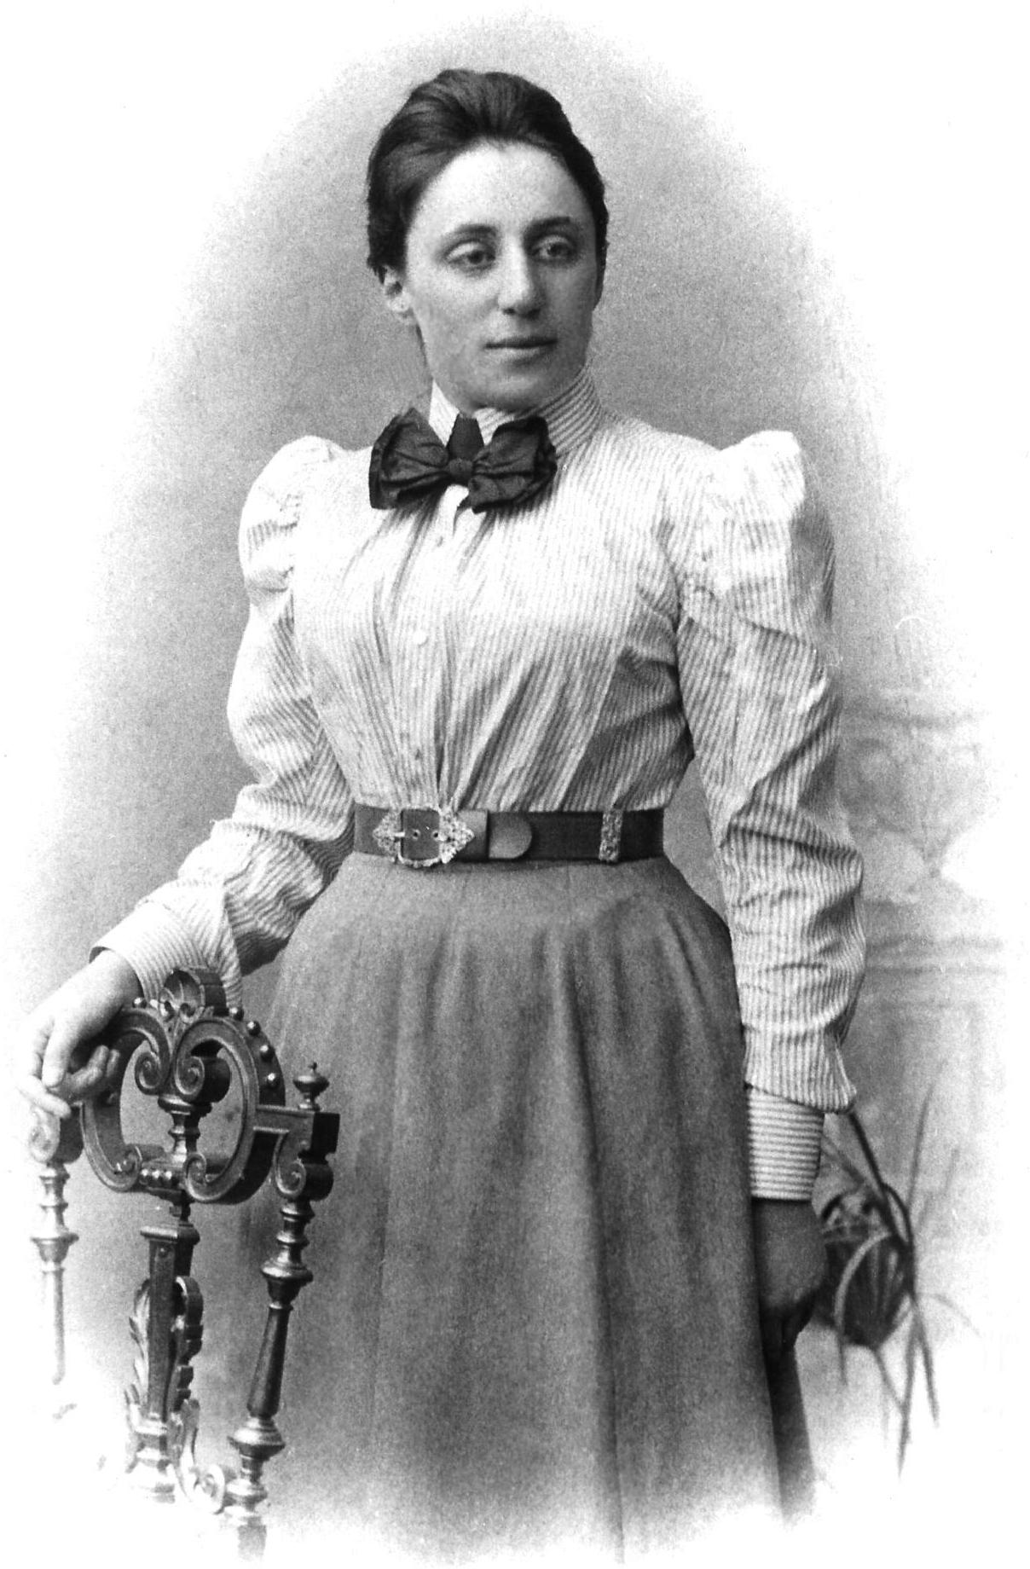
Persistent homology
Homology
Enrico Betti
Photos from Wikipedia
Emmy Noether

Slide 32
Persistent homology
Homology
  Fundamental tool in algebraic topology

Slide 33
Persistent homology
Homology
  Fundamental tool in algebraic topology
  Measures connectivity of a space

Slide 34
Persistent homology
Homology
  Fundamental tool in algebraic topology
  Measures connectivity of a space
  Define/compute using linear algebra

Slide 35
Persistent homology
Homology
  Fundamental tool in algebraic topology
  Measures connectivity of a space
  Define/compute using linear algebra
Persistent

Slide 36
Persistent homology
Homology
  Fundamental tool in algebraic topology
  Measures connectivity of a space
  Define/compute using linear algebra
Persistent
  A data set gives rise to a sequence of spaces

Slide 37
Persistent homology
Homology
  Fundamental tool in algebraic topology
  Measures connectivity of a space
  Define/compute using linear algebra
Persistent
  A data set gives rise to a sequence of spaces
  Track where in the sequence clusters, holes, etc. appear, persist, disappear

Slide 38
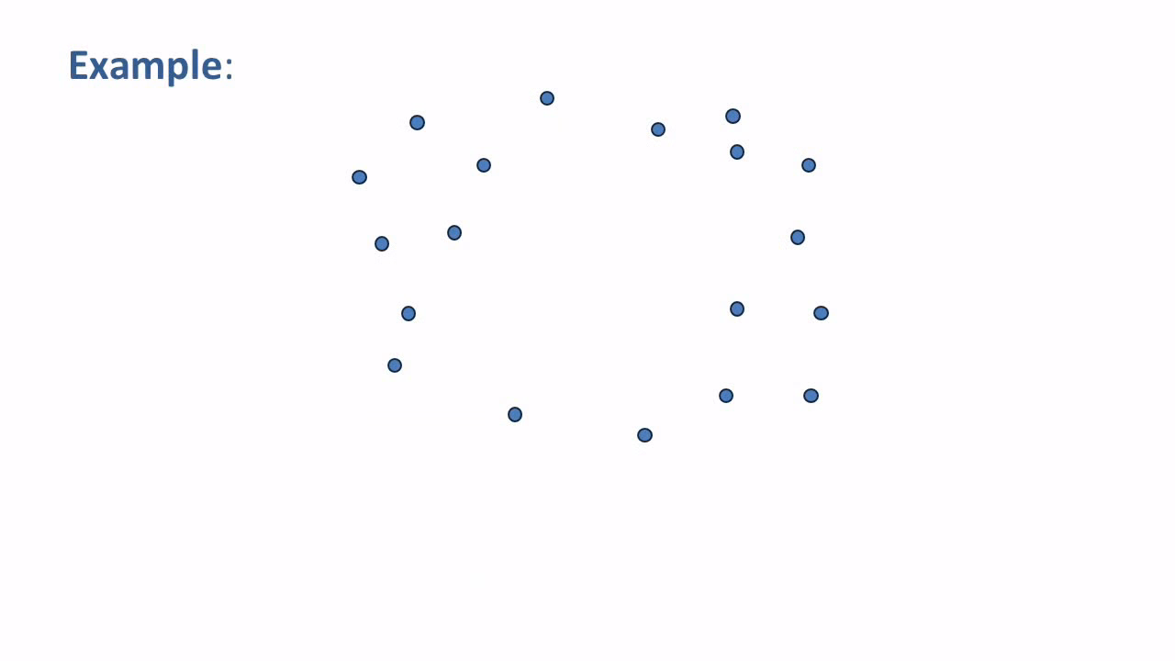
Video by Matthew Wright, St. Olaf Collage

Slide 39
Outline
Today
Lecture 2
Lecture 3

Slide 40
Outline
Today
  Simplices and simplicial complexes
Lecture 2
Lecture 3

Slide 41
Outline
Today
  Simplices and simplicial complexes
  Vietoris-Rips complex of a dataset
Lecture 2
Lecture 3

Slide 42
Outline
Today
  Simplices and simplicial complexes
  Vietoris-Rips complex of a dataset
Lecture 2
  Linear algebra (groups, fields, vector spaces, linear maps)
Lecture 3

Slide 43
Outline
Today
  Simplices and simplicial complexes
  Vietoris-Rips complex of a dataset
Lecture 2
  Linear algebra (groups, fields, vector spaces, linear maps)
  Homology of a simplicial complex
Lecture 3

Slide 44
Outline
Today
  Simplices and simplicial complexes
  Vietoris-Rips complex of a dataset
Lecture 2
  Linear algebra (groups, fields, vector spaces, linear maps)
  Homology of a simplicial complex
Lecture 3
  Maps of simplicial complexes

Slide 45
Outline
Today
  Simplices and simplicial complexes
  Vietoris-Rips complex of a dataset
Lecture 2
  Linear algebra (groups, fields, vector spaces, linear maps)
  Homology of a simplicial complex
Lecture 3
  Maps of simplicial complexes
  Functoriality

Slide 46
Outline
Today
  Simplices and simplicial complexes
  Vietoris-Rips complex of a dataset
Lecture 2
  Linear algebra (groups, fields, vector spaces, linear maps)
  Homology of a simplicial complex
Lecture 3
  Maps of simplicial complexes
  Functoriality
  Diagrams of complexes from datasets

Slide 47
Outline
Today
  Simplices and simplicial complexes
  Vietoris-Rips complex of a dataset
Lecture 2
  Linear algebra (groups, fields, vector spaces, linear maps)
  Homology of a simplicial complex
Lecture 3
  Maps of simplicial complexes
  Functoriality
  Diagrams of complexes from datasets
  Barcodes and persistent homology

